Slide 1
UNIVERSITY WEBSITE
BY:-
OMKAR , DEVANSH , AKHILESH , ASHUTOSH

Slide 2
AIM:
Promoting the University's brand, values, capabilities, expertise and activities
Attracting and recruiting people to study here
Providing information and services that are responsive to our internal user and business needs
Facilitating relationships with business, industry and the community.

Slide 3
What an user can experience?
From this website an user can -
A user can view the current and latest information .
Can view the information related to admissions.
Can view the courses offered .
Can view the international admissions & scholarships
Can login and view their attendance , result , pending fees.
Can view the placement record and latest info. about placement drives.
Can view the events and functions organised in university.

Slide 4
MODULES:
HOME PAGE
LOG-IN(FACULTY & EXISTING USERS)
LOG-IN & SIGN UP (GUEST USERS)
ADMISSIONS – ADMISSION FORM ,LPU NEST PAGE
INTERNATIONAL ADMISSIONS
COURSES
CONTACT
GALLERY

Slide 5
RESPONSIBLE PERSONS:
NAME WORK
OMKAR | -- HOME PAGE --GALLERY --HEADER --ABOUT US --CONTACT US
ASHUTOSH | --FACULTY AND EXISITING STUDENT LOGIN PAGE --GUEST LOGIN AND SIGNUP PAGE --NAVIGATION BAR --FOOTER AT HOME PAGE

Slide 6
NAME WORK
DEVANSH | -- REGISTRATION PAGE --COURSES OFFERD --APPLY NOW
AKHILESH | --ADMISSIONS --PLACEMENT CELL --PAYMENT

Slide 7
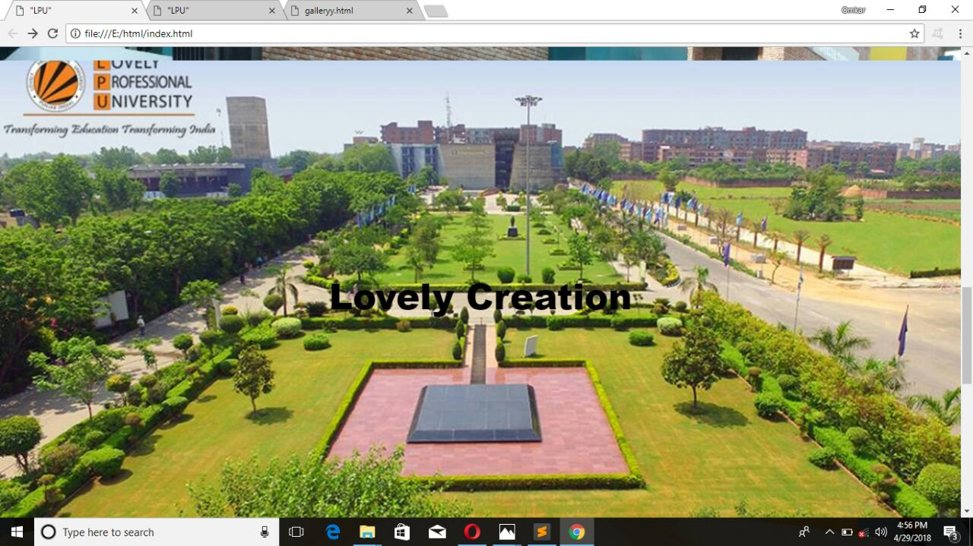
SNAPSHOTS:-

Slide 8
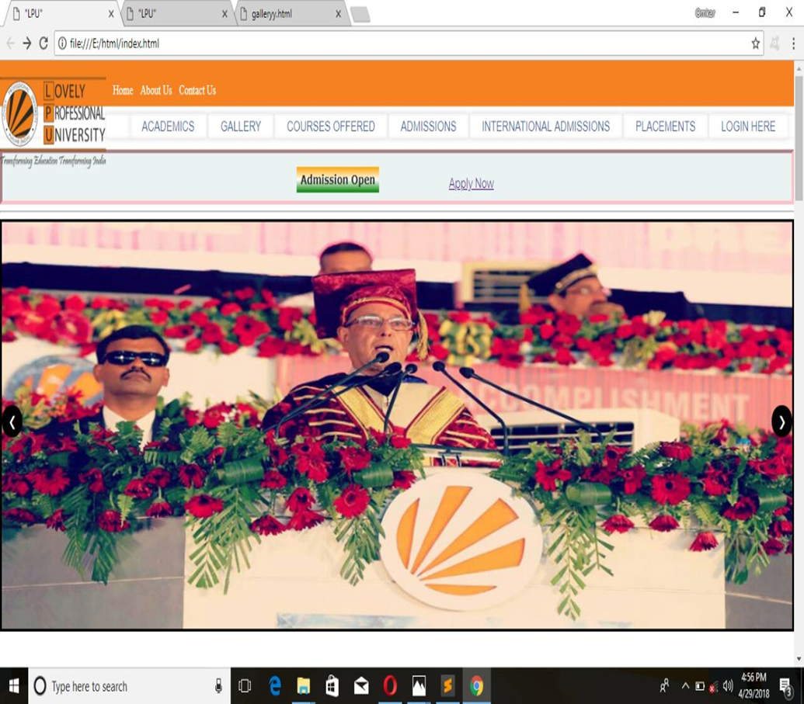

Slide 9
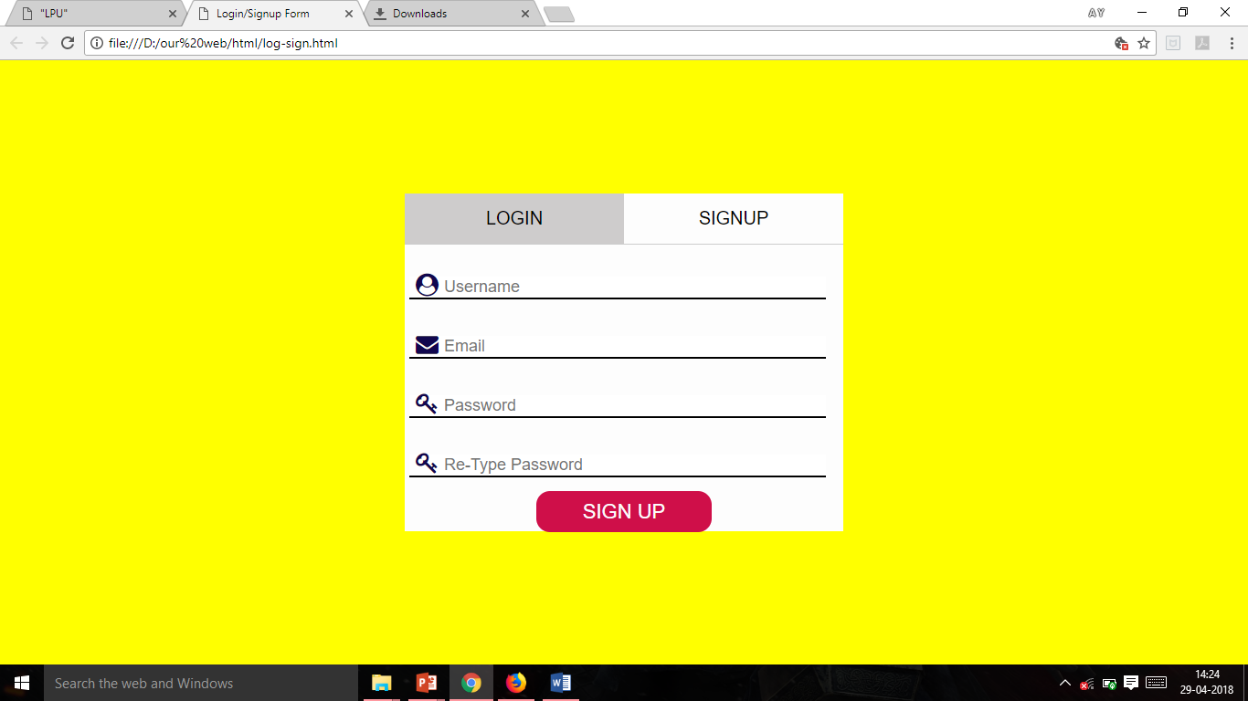
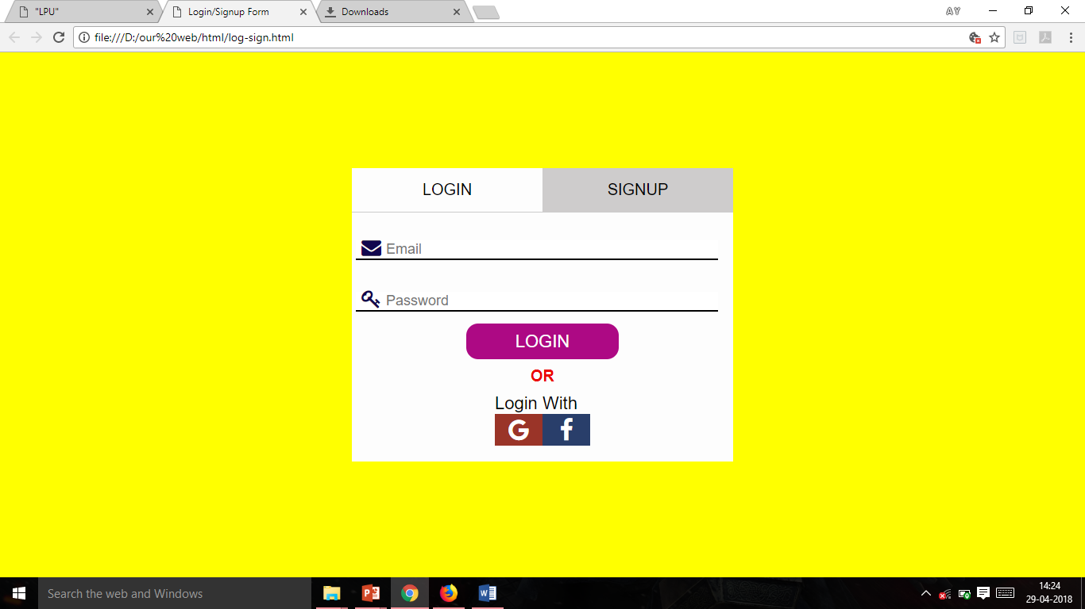
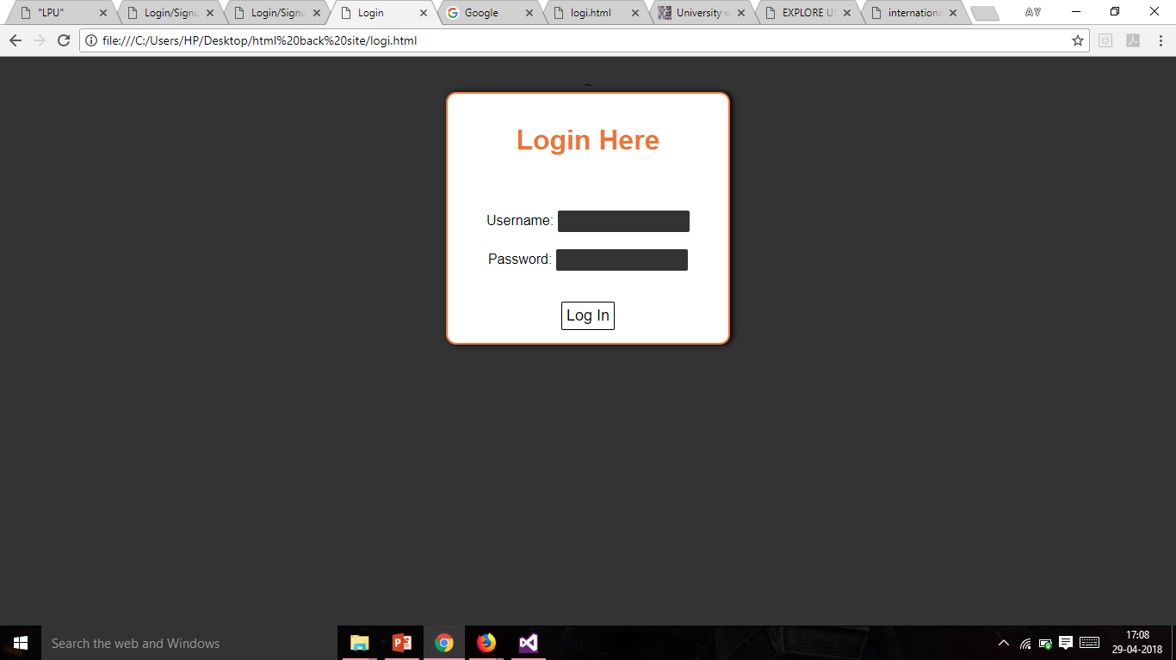

Slide 10
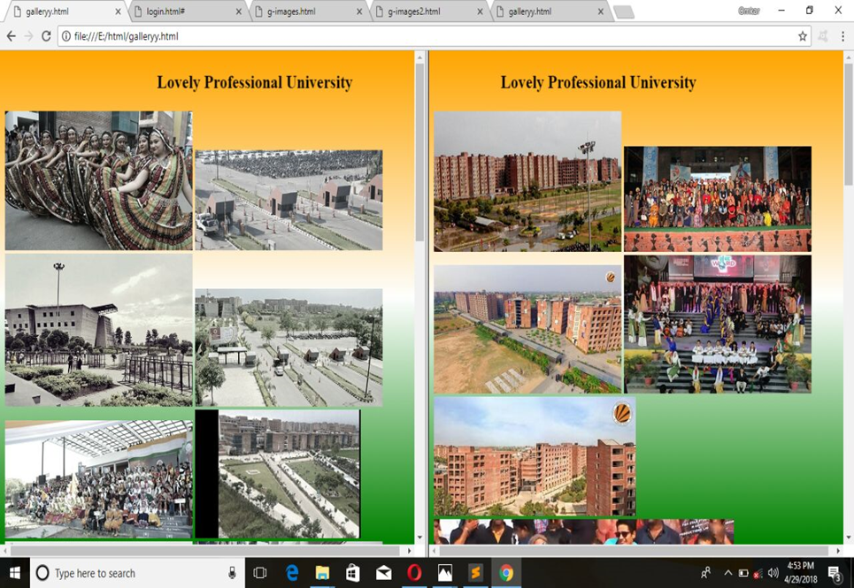

Slide 11
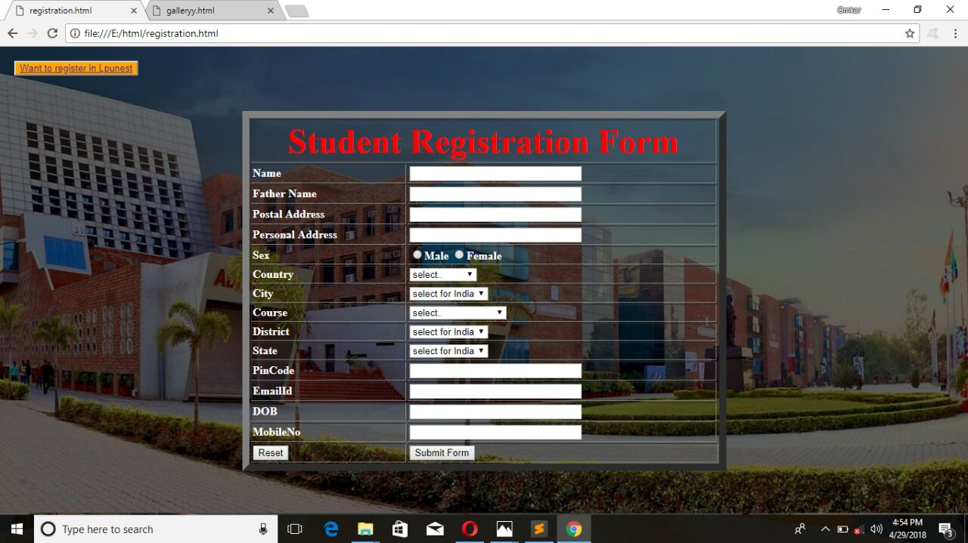
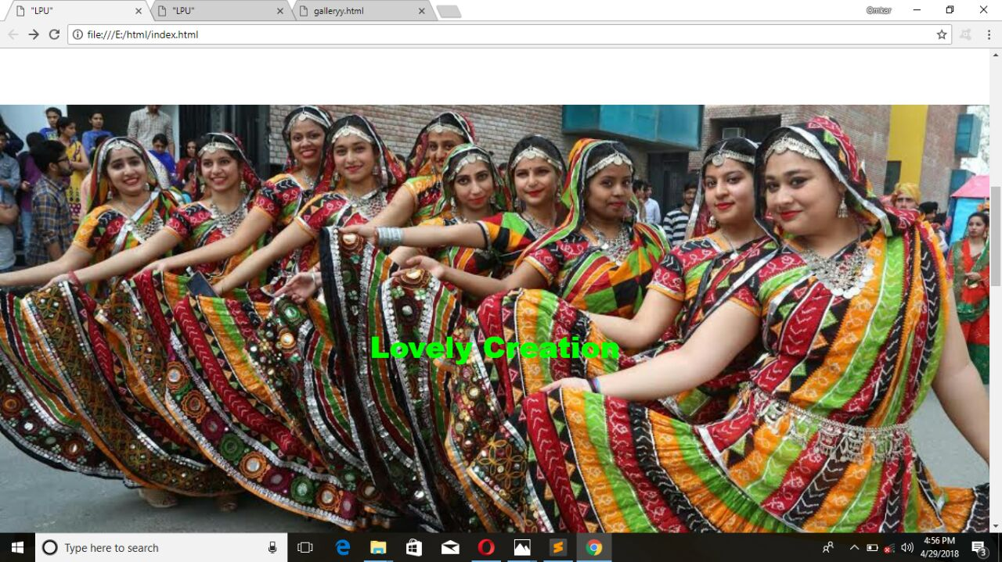

Slide 12
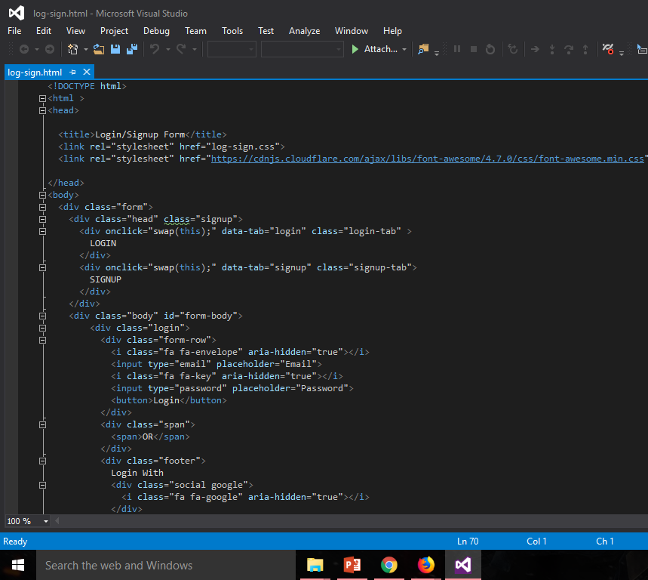
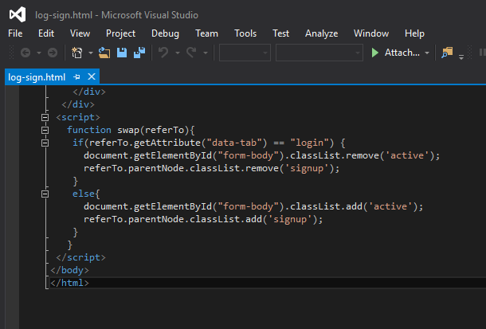
CODING PART->

Slide 13
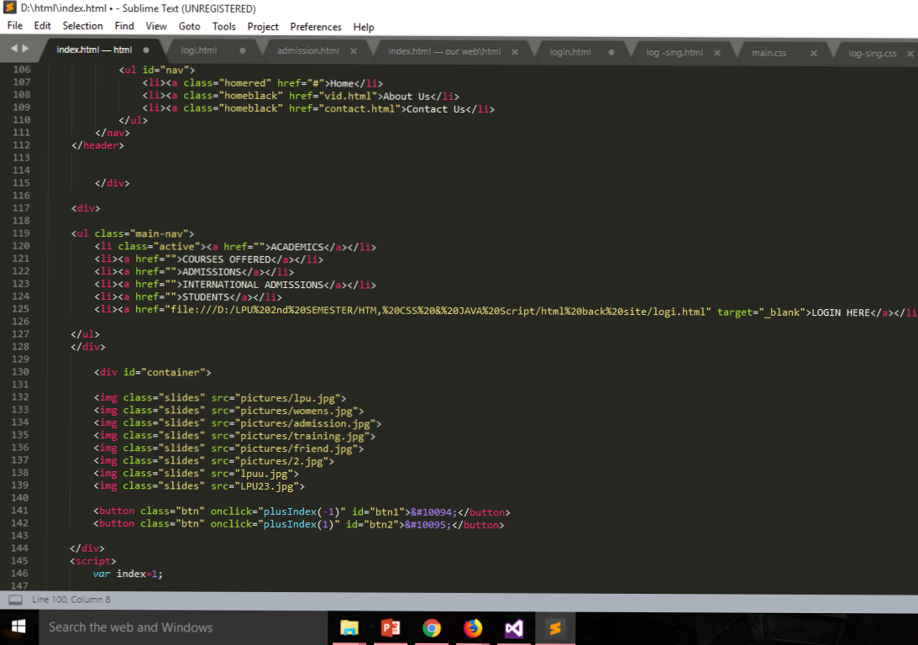
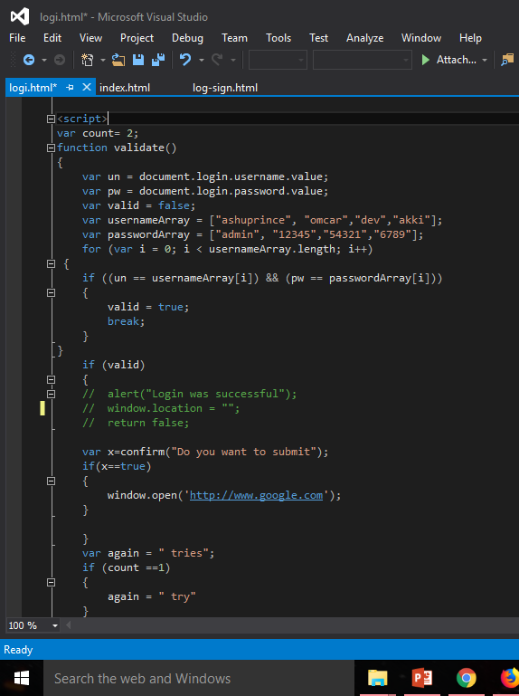

Slide 14
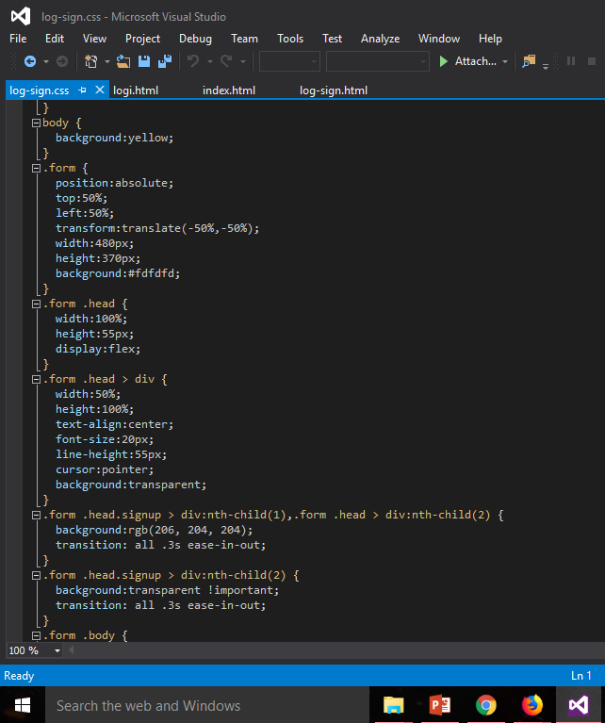
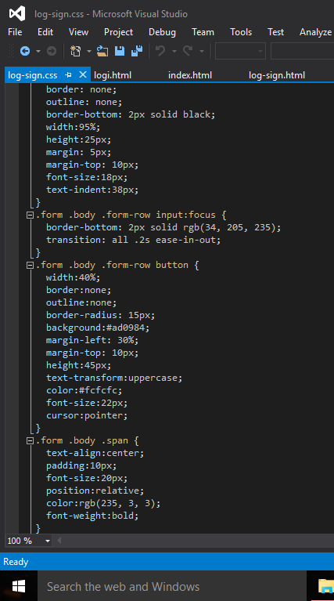

Slide 15
